Slide 1
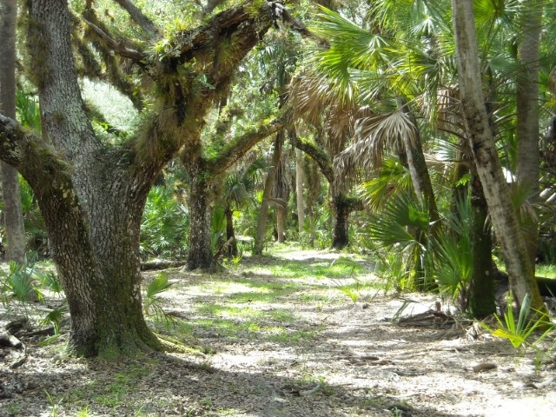
Trail Easements on Private Lands
A way to generate public support
for conservation easement purchases
By:
Sean M. Byrne, Esq.
Attorney, Bach & Jacobs, P.A.
Counsel, Conservation Foundation of the Gulf Coast
&
Albert Joerger, Ph.D.
President, The Joerger Group
Founder, Conservation Foundation of the Gulf Coast
Image Credit: https://www.scgov.net/NaturalResources/Natural/Shady%20Trail%20-%20Carlton%20Ranch.jpg

Slide 2
About us
Conservation Foundation of the Gulf Coast
  An Accredited Land Trust in Osprey, FL that conserves land to protect bays, beaches, barrier islands, & watersheds along Southwest Florida’s Gulf Coast.
The Joerger Group
  A consultancy assisting clients in the areas of conservation branding, conservation finance, land conservation, conservation leadership and training, environmental policy, land planning and real estate

Slide 3
Learning Objectives
Learn how to incorporate a trail easement into a conservation transaction by:
Using the ‘public access’ component to marshal public support for using public funds to acquire conservation easements on private lands
Addressing a landowner’s concerns about granting public access to private lands
Understanding the legal and practical considerations that go into negotiating and drafting trail easements

Slide 4
Roadmap
What are trail easements and why do we need them?
How do we address landowner concerns about granting trail easements?
What are the legal and practical considerations that go into drafting and negotiating trail easements?
What can we learn from Sarasota County’s “River to River” trail system?

Slide 5
What is an easement?
An easement is a nonpossessory interest in the land of another. (Source: The Law of Easements & Licenses in Land § 1:1, by Ely and Bruce)
Easements can be temporary or permanent
Original landowner still retains full property ownership
For Example:
  Right of way easements- grant access for trails, sidewalks, utilities, driveways, etc.
  Conservation easements- limit property development
  View easements- restrict height of buildings

Slide 6
What is a conservation easement?
Conservation easements are designed to preserve undeveloped lands and keep them in their natural state forever (Source: The Law of Easements & Licenses in Land § 12:2, by Ely and Bruce)
Landowners usually donate or sell conservation easements to government agencies or private land trusts
Landowners who donate land for conservation are eligible for federal income tax deductions and sometimes state tax benefits (income tax credits/property tax exemption, etc.)

Slide 7
What is a trail easement?
A trail easement grants a party access to cross through another’s private land.
  Hiking
  Biking
  Running
  Off-roading
  Horseback riding

Slide 8
National Hiking Trails

Slide 9
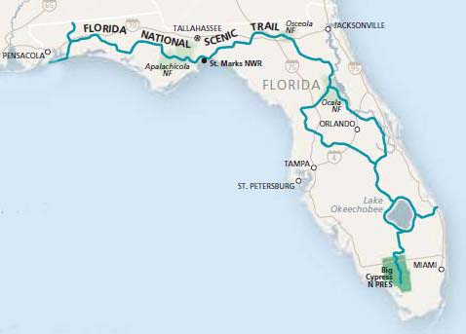
Florida National
Scenic Trail
Over 1,500 miles through:
Big Cypress National Preserve,
Ocala National Forest,
Osceola National Forest,
Apalachicola National Forest,
St. Marks National Wildlife Refuge,
Numerous State & Local Forests, Parks, and Preserves

Slide 10
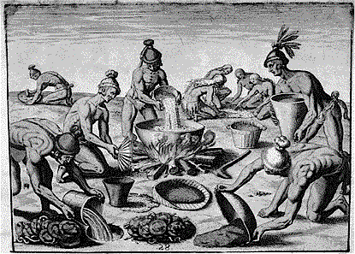
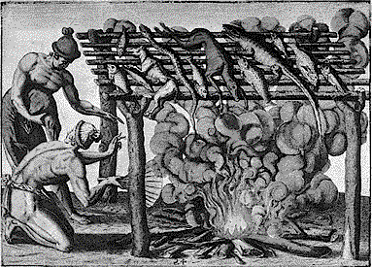
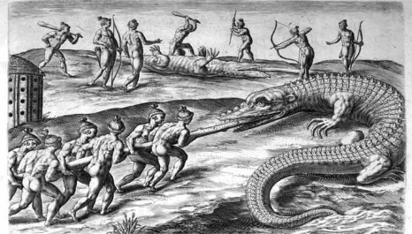
Florida Fact
Humans began to settle Florida about 12-14 thousand years ago.
It is estimated that about 350,000 Native Americans inhabited Florida when Europeans arrived.
“Barbacoa”

Slide 11
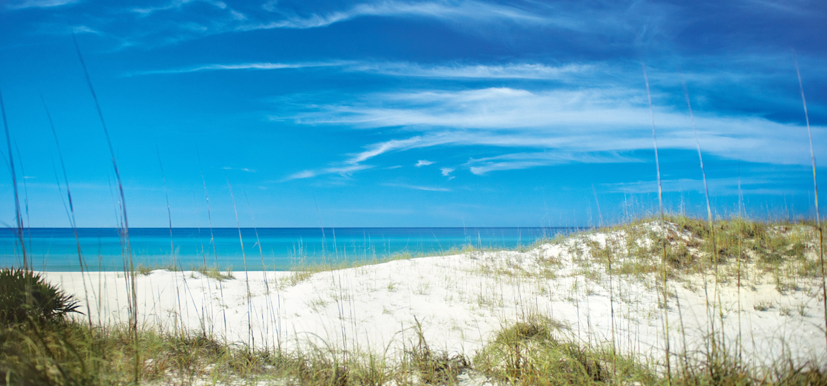
Florida Trivia
Who can name the most official Florida state symbols?
Official Beverage
Official Bird
Official Animal
Official Tree
BONUS: Official Shell

Slide 12

Answers?
Beverage = Orange Juice
Bird = Mockingbird
Animal = Panther
Tree = Sabal Palm
BONUS:
  Shell = Horse Conch >>>

Slide 13
Engaging taxpayers in using public funds for conserving private lands
When the economy is bad and government budgets are tight, how do you increase support for conservation purchases?
  Trail easements make it easier for elected officials to justify expenditures on private lands because they provide a more direct benefit to the public
  In addition to preservation, the public is granted access and can interact with the land

Slide 14
How does a trail easement benefit the public?
Promotes public health and recreation
Allows public interaction with the environment
Increased environmental awareness
Eco-tourism and increased economic activity
Community pride

Slide 15
How does a landowner benefit from a trail easement?
Still retains ownership despite granting public access to a small portion of the land
Often receives compensation for easement
Possibly eligible for property, income tax deductions
Demonstrates environmental philanthropy and community mindedness
Increased property value due to proximity to trail
Economic potential of providing services to trail users

Slide 16
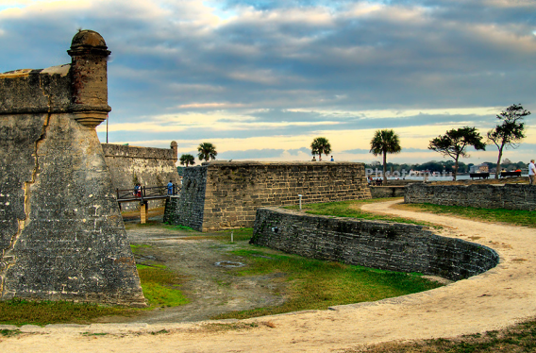
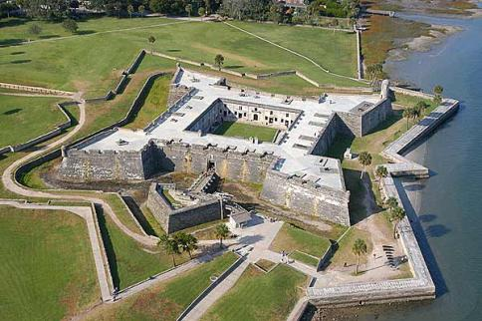
Florida Fact
Founded in 1565, St. Augustine, FL is the oldest continuously inhabited European settlement in North America.
For two centuries, it served as the capital of Spanish Florida.

Slide 17

Florida Trivia
Florida leads the nation in ALL BUT WHICH of the following…
Foreclosures
Boating accidents
Cash-Only home sales
Uninsured citizens
Production of sugar cane

Slide 18

Answer?
Texas leads the nation in uninsured citizens

Slide 19
Addressing landowner concerns about granting public access to private property
Liability
Privacy
Trespassers and disorderly visitors
Property damage
Interference with business operations
Property devaluation

Slide 20
Landowner Liability
How do landowners limit their liability?
  Landowners prefer to be indemnified by an insured easement holder
  49 states have enacted recreational use statutes, which grant landowners immunity from potential negligence lawsuits when the public uses their land for recreational purposes (Source: Recreational Access to Private Lands by John Copeland)
Notes:
Alaska provides immunity for natural conditions on unimproved lands

Slide 21
Landowner Liability
How can a landowner qualify for immunity under a recreational use statute?
  In most states, a landowner must grant free public access to their land for outdoor recreational purposes (Source: Recreational Access to Private Lands by John Copeland)
  These statutes generally apply to rural or natural lands (Source: Recreational Access to Private Lands by John Copeland)

Slide 22
Landowner Liability
How much immunity from liability does a landowner have?
  In most states, landowners have no duty of care to keep their land safe and often have no duty to warn visitors of potential dangers or hazards (Source: Recreational Access to Private Lands by John Copeland)
  This standard is equivalent to the duty of care usually afforded to trespasser
  Florida: Landowner owes no duty of care to keep land safe or warn visitors of any hazardous conditions. But no immunity for deliberate, willful, or malicious injury to persons or property (Fla Stat § 375.251)

Slide 23
Landowner Liability
BUT landowners can still be held liable if their actions or omissions constitute gross negligence, reckless negligence, or willful or malicious conduct
In many states, landowners have a duty to warn or protect visitors from probable and foreseeable dangers that are known to the landowner.
GA, NY, NJ, & CA: Landowner owes no duty of care to keep land safe or warn of hazardous conditions UNLESS there is a willful or malicious failure to guard or warn against a dangerous condition, use, structure, or activity (Cal Civ Code § 846; N.Y. Gen. Oblig. Law § 9-103; Ga Code § 51-3-20; NJ Stat § 2A:42A)

Slide 24
Landowner Liability
Examples of gross or willful negligence:
  Hidden or Submerged Tree Stumps: In Stephens v. US (C.D. Ill. 1979), the plaintiff dove into a lake and hit his head on a submerged tree stump. The recreational use statute required owners to warn the public about the dangers of submerged tree stumps which are known to the landowner.
  Landowner-Created Hazards: In Krevics v. Ayars (N.J. Co. 1976), the recreational use statute did not protect a landowner from placing a cable across a motorbike trail to keep people out. There was no warning of the cable and a biker ran into it at dusk.
Conduct that is not willfully negligent:
  Fallen Trees: In Conklin v. Woodcock (Conn. 1997), the plaintiff tripped over a fallen tree lying across a hiking trail. The court held that there was no willful or malicious conduct. Landowner did not know the tree had fallen and therefore did not intentionally fail to remove it or warn of the danger.
  Damaged Guardrails: In Sega v. State (NY 1983), a hiker fell into a creek bed while she was resting on a pedestrian bridge and leaning against what appeared to be a damaged guardrail. The court held that landowners owed no duty to warn about the defective railing.

Slide 25
Privacy
How do landowners prevent visitors from encroaching on their privacy or interfering with business operations?

Slide 26

Image credit: http://www.quickmeme.com/search/3/?q=my%20sh

Slide 27
Privacy: Trail Location and Boundaries
Where on the property should the trail be located?
  Most landowners prefer to place trails at the edge of their property to reduce interference with the interior
  Consider whether there is an existing trail, dirt road, or utility corridor
  Focus on clearing as little undisturbed habitat as possible

Slide 28
Privacy: Entry and Exit Points
How will visitors enter and leave the trail?
  Most landowners prefer as few entry and exit points as possible.

Slide 29
Privacy: Trail Width
How wide should a trail be?
  A functional trail corridor could be between 12 and 50 feet wide
  Typically, the actual trail surface will be narrower than the width of the easement

Slide 30
Problem: Trespassers, property damage, and tomfoolery
How can a landowner prevent trail visitors from leaving the trail and trespassing onto adjacent property?
How does a landowner ensure that people behave on the trail?
How does a landowner prevent damage to property and infrastructure?

Slide 31
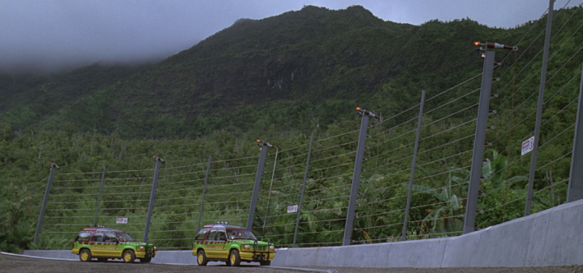


Slide 32
Solutions: Fencing
How can a landowner prevent trail visitors from leaving the trail and trespassing onto adjacent property?
  Electric fences with video monitoring are unnecessary
  It is important to preserve the aesthetic nature of the surrounding habitat and allow animals to cross the trail
  Consider having a buffer area between the trail and any fencing
  Signs or rope fences may be sufficient to keep hikers on the trail
Also consider what materials the fence will be made of and who is responsible for construction.

Slide 33
Solutions: Trail Rules
What type of activities will be permitted on the trail?
  Consider whether the trail will be limited to hiking, biking, outdoor enjoyment, or other activities
What type of activities will be prohibited?
  Littering, camping, smoking, excessive noise, etc.
How will the rules be enforced?
  Both landowner and easement holder can reserve the right to enforce the rules and eject visitors
  Landowner and easement holder also need to determine who will enforce trail rules
When will the trail be open?
  After construction? After fence installation?
  Daily? Or only on weekends?
  Daytime only? Or 24 Hours?

Slide 34
Solutions: Signs and Postings
Who is responsible for creating, installing, and maintaining signs?
  Usually, the easement holder will be responsible
Where will signs be located?
  Signs along the trail will notify visitors of the boundaries and rules

Slide 35
Trail Construction and Maintenance
Who is responsible for constructing and maintaining the trail?
  Usually, landowners prefer to make easement holders responsible for construction, maintenance, and damage repair
What labor and materials are required?
  Trail paths must be cleared and leveled
  Boardwalks or walkways may need to be built
  Trails made with permeable materials are preferable
Also, consider
  How much time will be allowed for construction of trail, fences, and infrastructure?
  What provisions are necessary to grant access for construction?
  Under what conditions the trail will be closed?

Slide 36
Reserving Landowner Rights
To what extent can landowners use the trail and adjacent property?
  Consider vehicle use, horses, hunting, etc.
To what extent does the trail impede land management?
  Consider whether trail interferes with existing utilities, any prior easement holders, or the execution of prescribed burns

Slide 37
Assessing Value
How much is the trail easement worth?
  Third-party appraiser usually determines the value
  What is the diminution in value of underlying fee property due to landowner surrendering right to exclude the public from a portion of landowner’s property?

Slide 38
Negotiating, Drafting, and Closing the Agreement
Step 1: Identify sources of funding
Step 2: Determine the value of the property and potential trail easement
Step 3: Negotiate and contract with the landowner
Step 4: Do Due Diligence
  Deed research
  Environmental assessment
Step 5: Close on acquisition and record transfer

Slide 39
One deed or Two?
Should the trail easement be incorporated into the conservation easement? Or should there be two separate documents?
  Either way is OK

Slide 40
Review
Trail Width
Trail Location and Boundaries
Entry and Exit Points
Trail Construction and Maintenance
Security and Fencing
Liability and Risk Management
Trail Rules
Reserving Landowner Uses and Rights
Assessing Value
Drafting, Negotiating, and Closing the Agreement

Slide 41
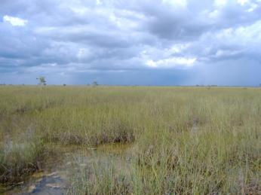
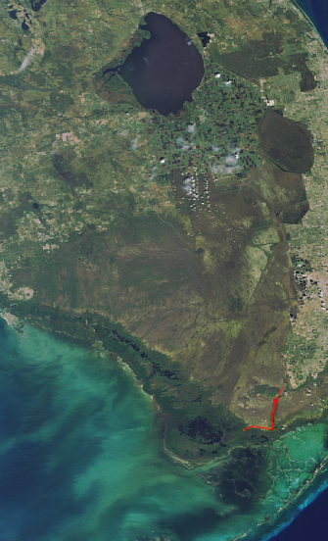
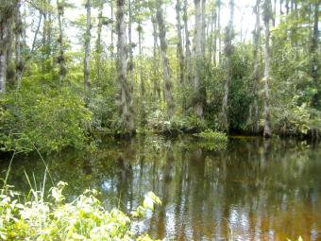
Florida Fact
The Everglades watershed is a slow moving river 60 miles wide and 100 miles long.
Water traverses south from Lake Okeechobee, through sawgrass marshes, freshwater sloughs, cypress swamps, pineland, and mangrove estuaries into Florida Bay.

Slide 42
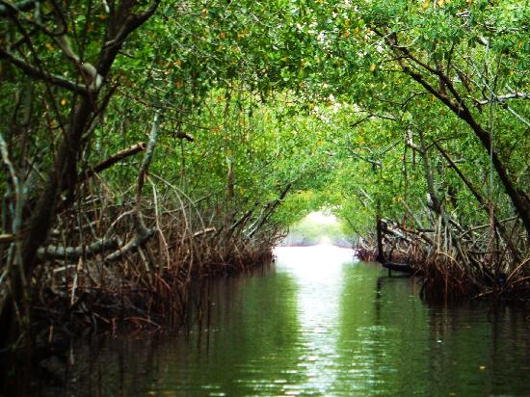
Florida Trivia
All of the following are TRUE about the Everglades, except…
Coushatta Indians inhabited
Slowest river in world
Alligators & crocodiles co-exist
Largest mangrove ecosystem in western hemisphere

Slide 43
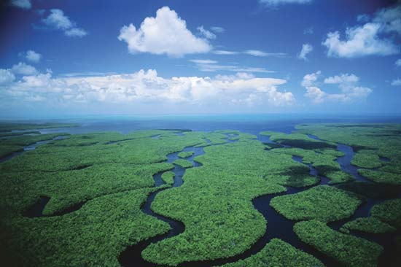
Answer?
Coushattas were in Texas, Louisiana, & Oklahoma
Everglades were populated by Calusa, Tequesta, and Seminole Native American Tribes

Slide 44
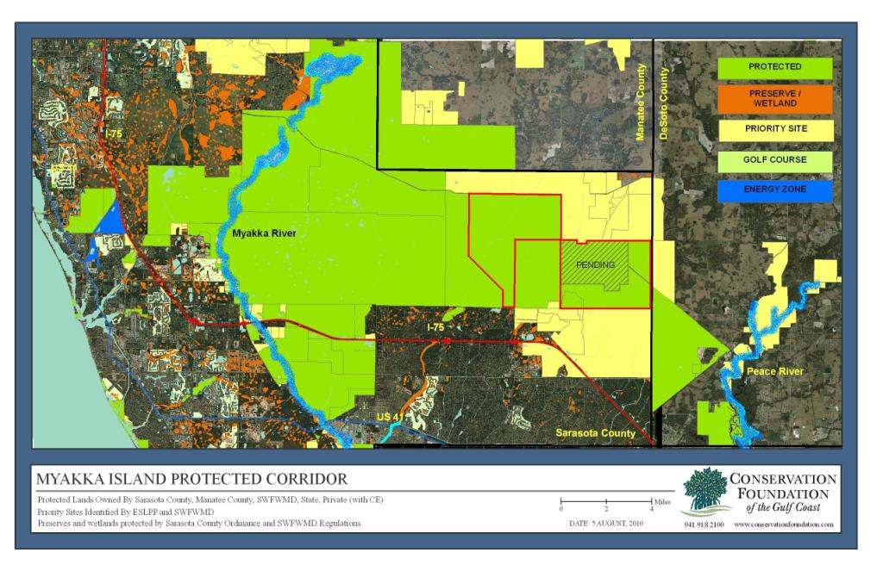
River to River Trail
MYAKKA ISLAND

Slide 45
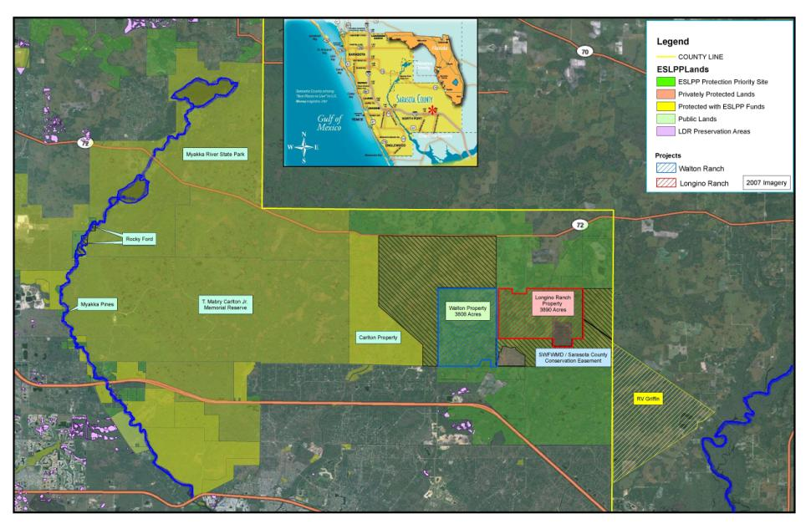
River to River Trail

Slide 46
River to River Trail
The Myakka River Landscape Island encompasses more than 106,000 acres and is larger than 22 of America’s National Parks.
Protecting these lands will safeguard regional water supplies, water quality, provide natural flood protection and recreational opportunities.
The ‘River to River’ trail, once constructed, will give the public access to 36 miles of uninterrupted trail, from RV Griffin Preserve at the Peace River, west to Myakka River State Park
Visitors can enjoy hiking, running, biking, horseback riding, bird watching, and educational study.

Slide 47
Carlton Ranch
Private working ranch
In 2007, Sarasota County and Southwest Florida Water Management District acquired a conservation easement for the property
Included in the easement was a 1/4-mile trail easement along the south edge of the property
The trail easement’s construction is contingent on adjacent properties being publicly owned

Slide 48
Carlton Ranch

Slide 49
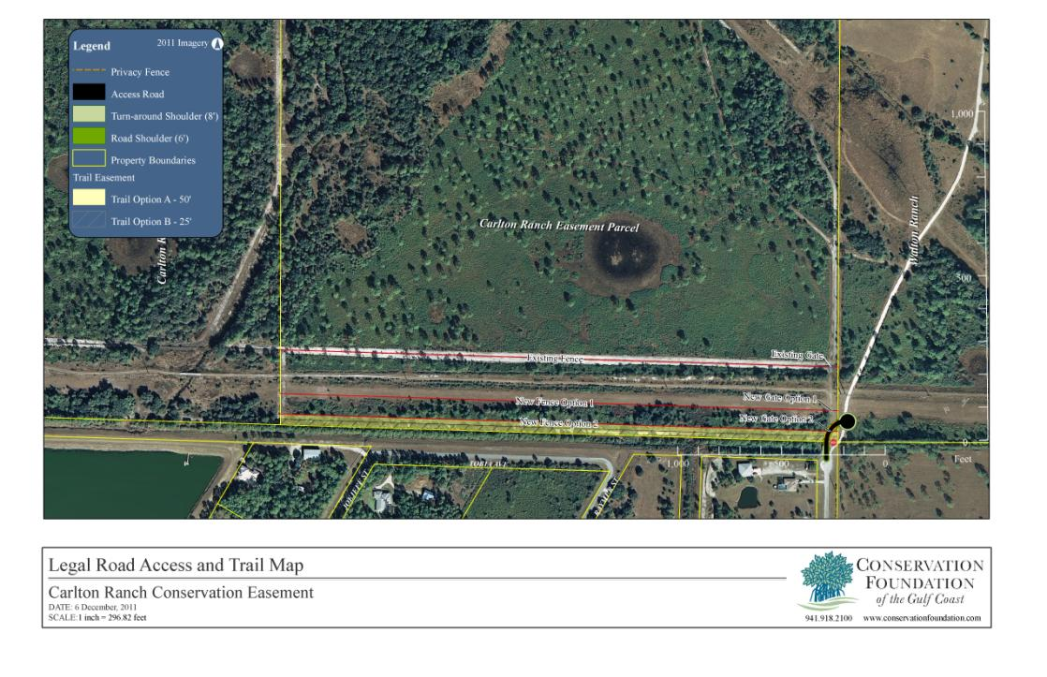
Carlton Ranch Trail

Slide 50
Longino Ranch
Private working ranch
In 2010, Sarasota County and Southwest Florida Water Management District acquired a conservation easement for the property
Trail Easement was included in the agreement, which grants public access to a 4 mile stretch of land
One mile of trail crosses a wetland mitigation bank

Slide 51
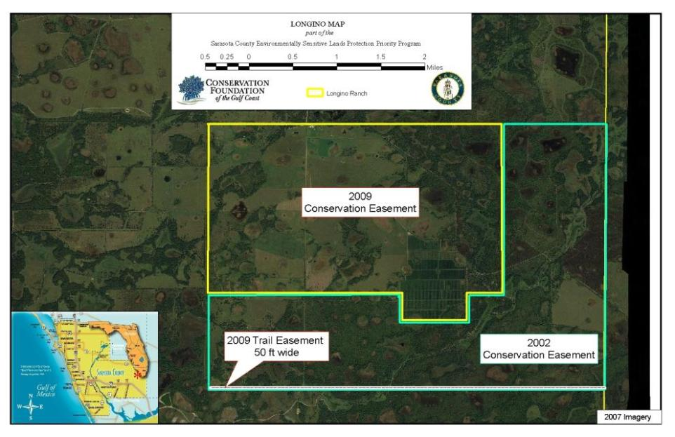
Longino Ranch
2nd CE
Trail Easement
1st CE

Slide 52
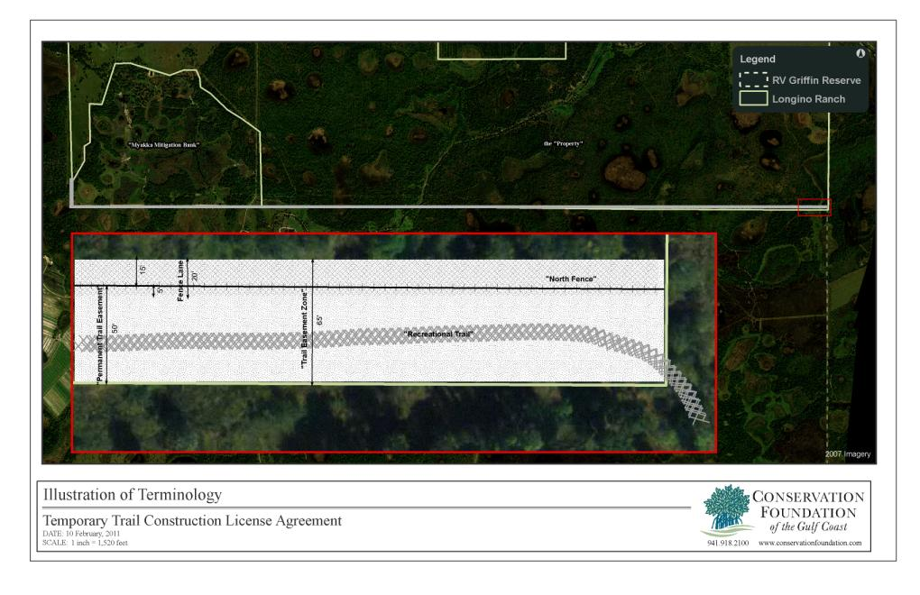
Longino Ranch Trail

Slide 53
Contact
Sean M. Byrne, Esq.
Bach & Jacobs, P.A.
240 S. Pineapple Ave, #700
Sarasota, FL 34236
sean@sarasotaelderlaw.com
bachjacobs.com
Albert Joerger, Ph.D.
The Joerger Group
P.O. Box 25907
Sarasota, FL 34227
albert@joerger.com
joerger.com

